Slide 1
IOT Project
Underfloor Heating Control System
Carmel Levi 319040549
Peleg Levy 315877639

Slide 2
Purpose
40% of all energy consumption comes from building services such as heating, ventilation and air-cooling conditioning (HVAC) systems. Our goal is to use Internet of Things (IoT) to target a reduction of wasted energy while heating and cooling buildings.

Slide 3
Internet of Things (IoT) comprises things that have unique identities and are connected to the Internet.
The focus on IoT is in the configuration, control and networking via the Internet of devices or “Things” that are traditionally not associated with the internet.

Slide 4
Our Product
The system allows the user to change the temperature of the heating system and allows to determine the status (Mode) remotely by controlling it from the phone using the application.
The system is based on the Internet, which can also be operated from the cell phone, as long as the user is within the range of cellular reception or Wi-Fi.
The system has a sensor that measures the ambient temperature and humidity and transmits this data to the system through the Broker. In addition, the phone will also be able to control the temperature and the state of the air conditioner by transmitting this data to the broker and the system will receive the same data and change the temperature and its state accordingly.

Slide 5

Our Product
The application has a home page which can turn-off/on the system, determine the system temperature and status.
Additionally, there is a temperature and humidity sensor transmit the data to the system every 10 seconds.
The sensor and the air conditioner are connected through the broker and transmit the data using the mqtt protocol.

Slide 6
01
Companies
02
Restaurants
Optimized energy usage and reduced operational costs and significant cost savings through energy waste reduction.
Enhanced customer comfort, operational efficiency, food safety compliance, employee satisfaction and environmental responsibility.
03
Private People
04
Institutions
Personalized comfort, energy efficiency, cost savings, equipment protection, health benefits, smart home integration.
Improved comfort, energy efficiency, cost savings, regulatory compliance, equipment protection.
Stakeholders

Slide 7



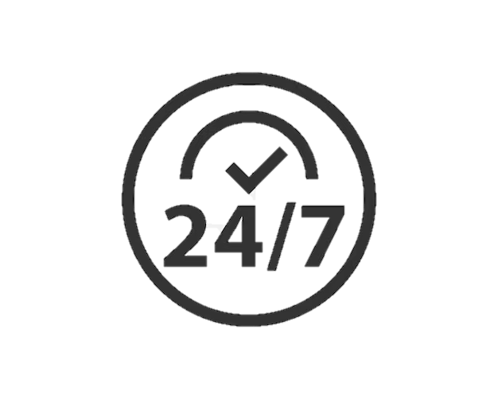
Product Requirements
The users can change and determine the required temperature
Push notification for thresholds exceeded
Functionality
The users can connect to the application any time to see the status of the system
Monthly reports

Slide 8



Product Requirements
The application will be with simple UI for friendly and easy use
The application will be available any time
Non -functionality
The system will be free and download from the applications store
The application will allow connection of 5 people simultaneously

Slide 9



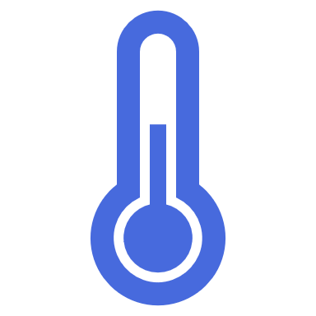
System Architecture
Mqtt Broker
Application
Temperature sensor
Humidity sensor
Heating system

Slide 10
System Architecture

Slide 11
Development Steps
01
Architecture and planning
02
Buying components and sensors
02
03
Software development
04
Tests
05
Advertising and marketing of the product

Slide 12
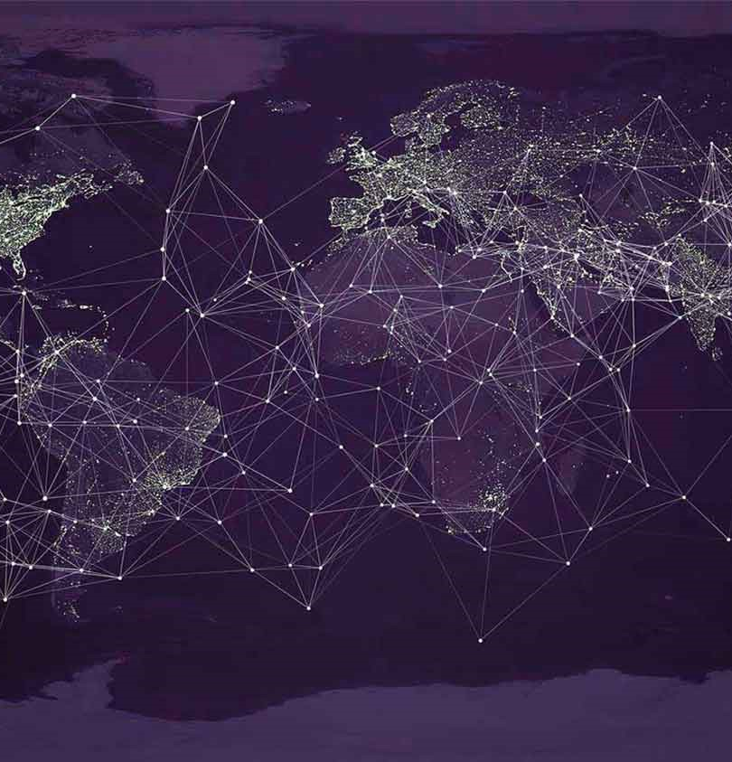
Product Risks
Potential risks of unauthorized access and data breaches.
Dependency on stable internet connectivity for system functionality.
Possibility of privacy violations and misuse of personal information.

Slide 13
Bibliography
https://www.researchgate.net/publication/318737482_An_IoT-ased_smart_electric_heating_control_system_Design_and_implementation

Slide 14
THANK YOU

